Slide 1


git + Github
a better workflow
Presented by: DEXTOR
IIIrd CSE A 17104041

Slide 2
git
git is an open source, distributed version control system designed for speed and efficiency
(almost) everything is local
Notes:
(almost) everything is local... branching, merging etc

Slide 3
No Network needed for
Performing a diff
Viewing file history
Committing changes
Merging branches
Obtaining any other revision of a file
Switching branches
(almost) everything is local
Notes:
(almost) everything is local... branching, merging etc

Slide 4
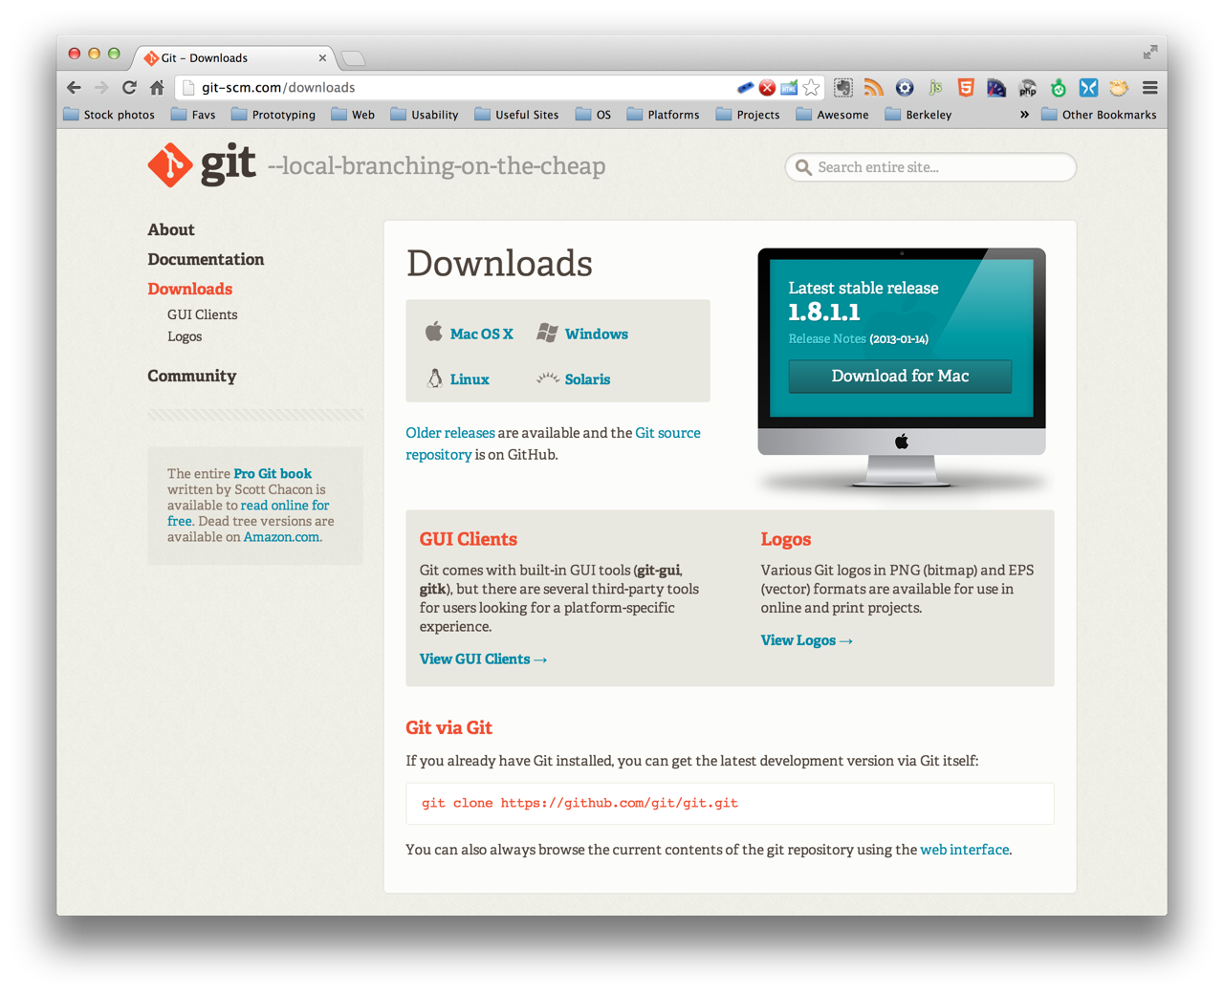
installing git
Notes:
We’ll be using the git command line interface, but feel free to choose your preferred solution GUIs, Editor Extension etc

Slide 5
getting setup ...
$ git config --global user.name “<YOUR_NAME>”
$ git config --global user.email “<YOUR_EMAIL>”
or edit them in ~/.gitconfig

Slide 6
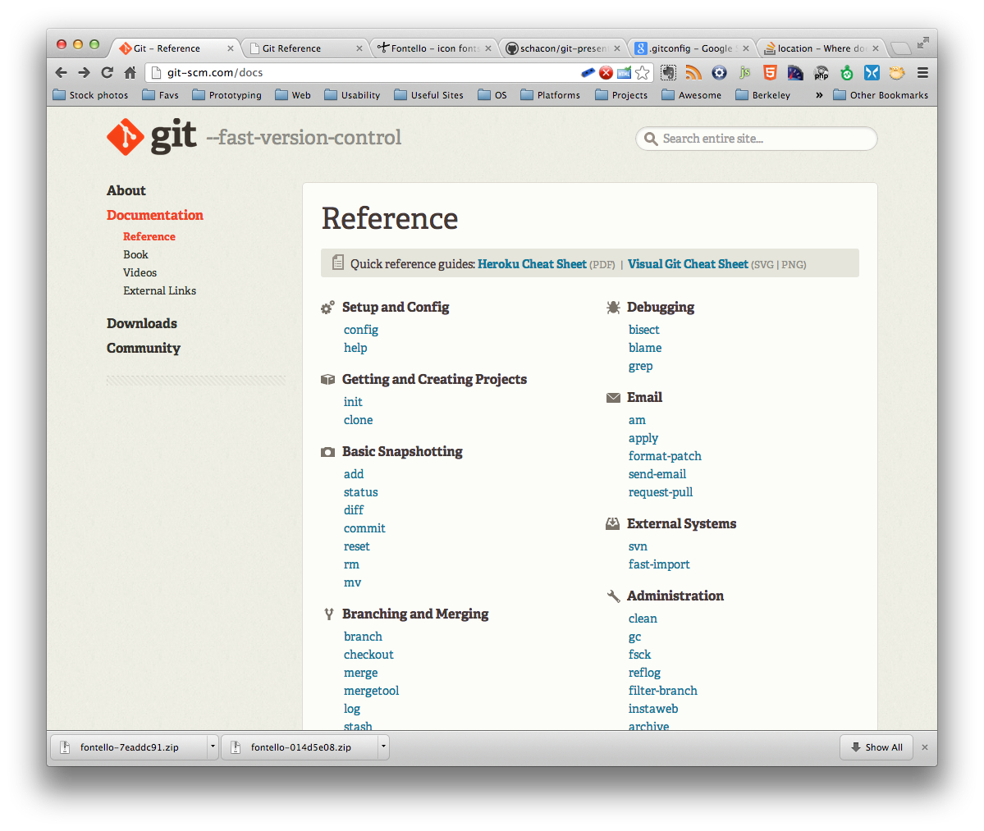
lets dive in..
Creating New Repo
Committing
Branching/Merging
Inspection
Cloning a Repo
Updating

Slide 7
Git Commands
$ git init
Creating New Repo
Committing
Branching/Merging
Inspection
Cloning a Repo
Updating
$ mkdir workspace
$ cd workspace
$ ls -al
$ git init
Initialized empty Git repository in ../workspace/.git/
$ ls -al

Slide 8
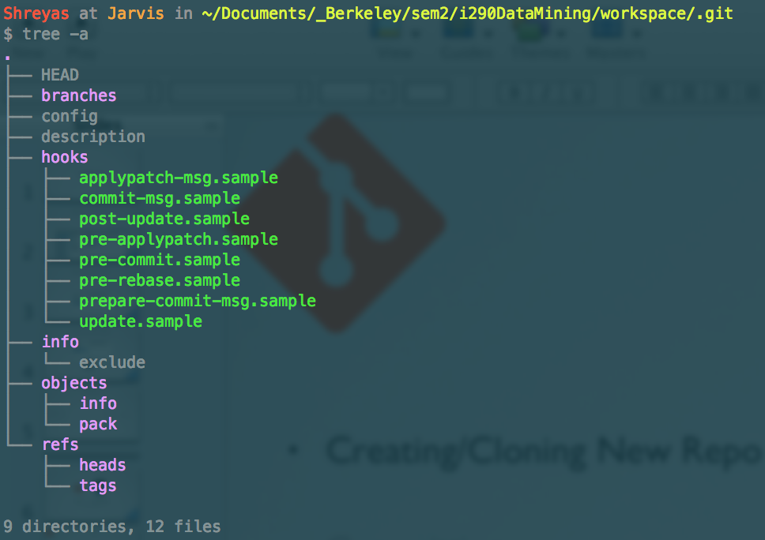
Git Commands
$ cd .git
Creating New Repo
Committing
Branching/Merging
Inspection
Cloning a Repo
Updating
$ tree -a

Slide 9
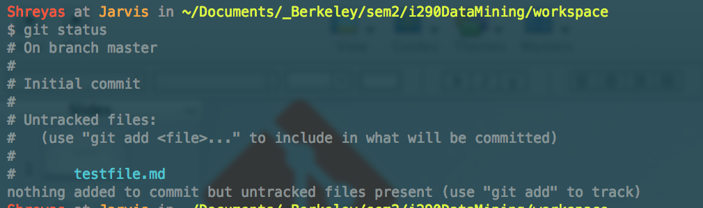
Git Commands
$ cd ..
$ touch testfile.md
Creating New Repo
Committing
Branching/Merging
Inspection
Cloning a Repo
Updating
$ git status
branch name
staging area

Slide 10
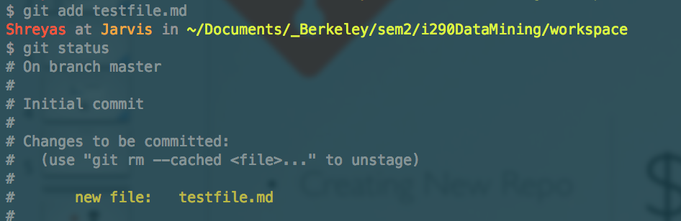
Git Commands
$ git add <filename>
Creating New Repo
Committing
Branching/Merging
Inspection
Cloning a Repo
Updating
$ git status
staging area

Slide 11
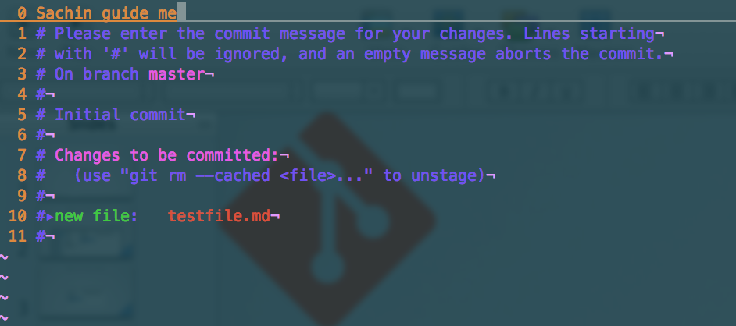
Git Commands
$ git commit
Creating New Repo
Committing
Branching/Merging
Inspection
Cloning a Repo
Updating
$ git status
your commit msg
Notes:
Although, I like working in small steps, here are some shortcuts
git commit -m “<your msg>” [doesn’t open up the editor for msg]
git commit -am “<your msg>” [adds the files tracked and uses msg on command-line]

Slide 12
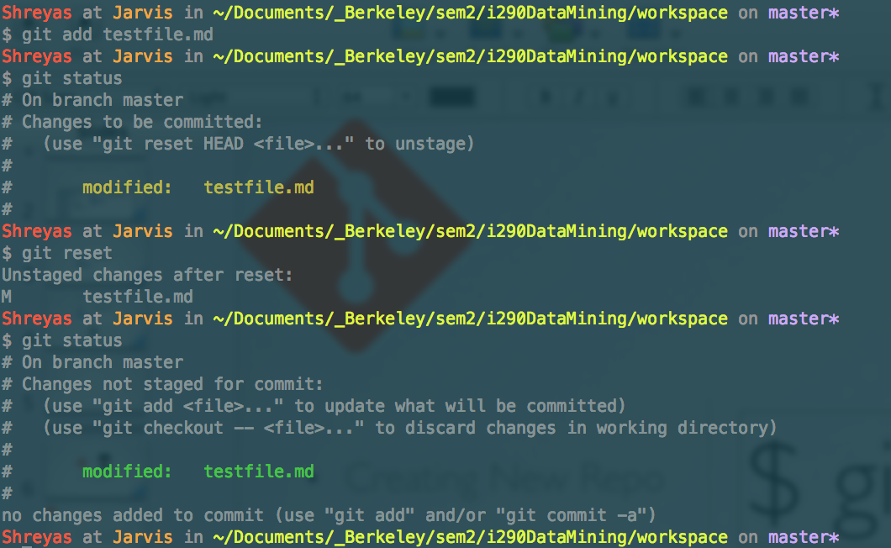
Git Commands
$ git reset
Creating New Repo
Committing
Branching/Merging
Inspection
Cloning a Repo
Updating
(undo add)
changes staged
changes unstaged

Slide 13
Git Commands
$ git reset --soft HEAD^
Creating New Repo
Committing
Branching/Merging
Updating
Inspection
Cloning A Repo
(undo a commit and redo)
$ git reset --hard HEAD~3
Rewind the branch to get rid of last three commits

Slide 14
Git Commands
$ git rm <filename>
Creating New Repo
Committing
Branching/Merging
Inspection
Cloning a Repo
Updating
remove a file from the repo
as expected, you will need to commit the change
$ git mv <filename>
move/rename a file from the repo
as expected, you will need to commit the change

Slide 15
Git Commands
$ git branch
Creating New Repo
Committing
Branching/Merging
Inspection
Cloning a Repo
Updating
list of branches
$ git branch <branchname>
new branch
$ git checkout <branchname>
switch

Slide 16
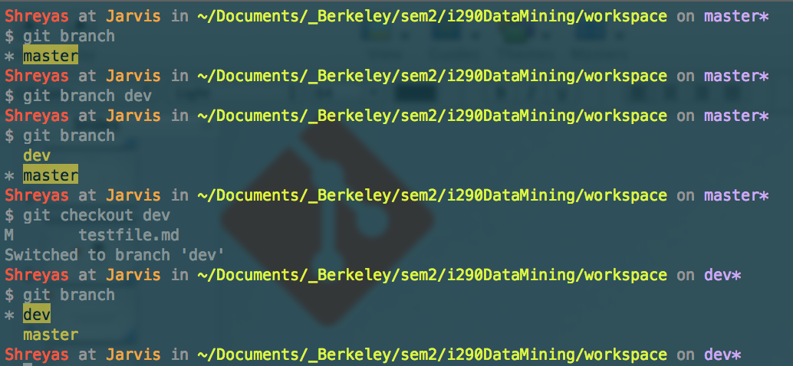
Git Commands
Creating New Repo
Committing
Branching/Merging
Inspection
Cloning a Repo
Updating
branch list
new branch dev
switch branch

Slide 17
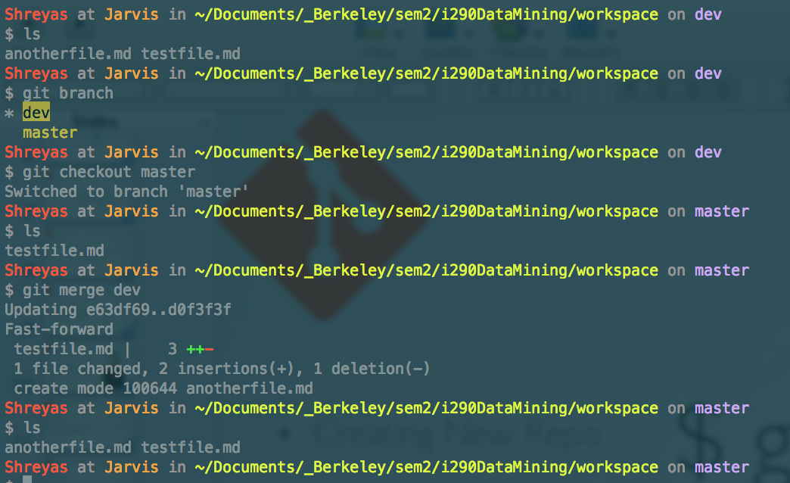
Git Commands
$ git merge <branchname>
Creating New Repo
Committing
Branching/Merging
Inspection
Cloning a Repo
Updating
merge branches
branch merge

Slide 18
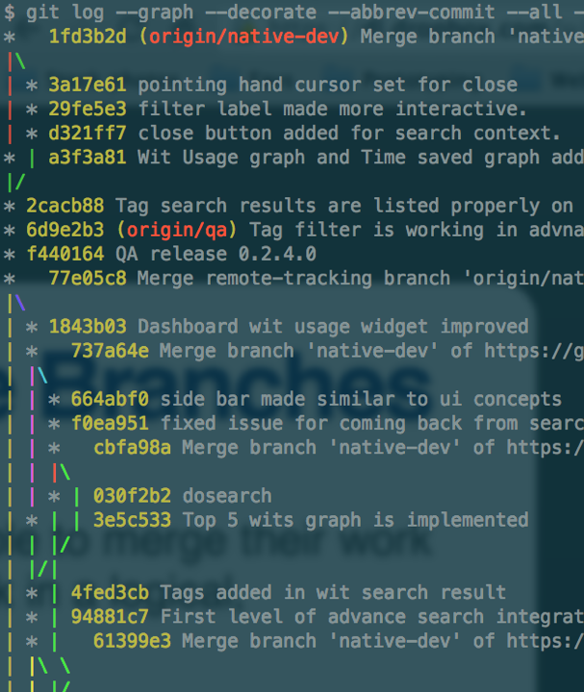
Git Commands
$ git log
--graph
--decorate
--abbrev-commit
--all
--pretty=oneline
Creating New Repo
Committing
Branching/Merging
Inspection
Cloning a Repo
Updating

Slide 19
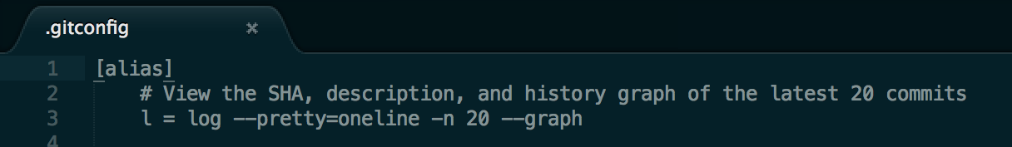
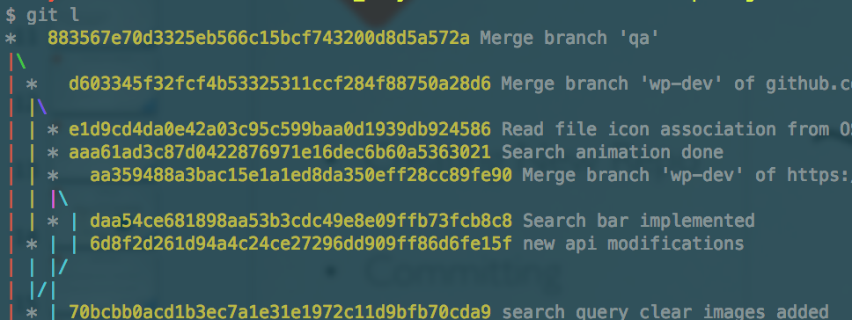
Git Commands
~/.gitconfig
[alias]
l = log --pretty=oneline -n 20 --graph
Creating New Repo
Committing
Branching/Merging
Inspection
Cloning a Repo
Updating

Slide 20
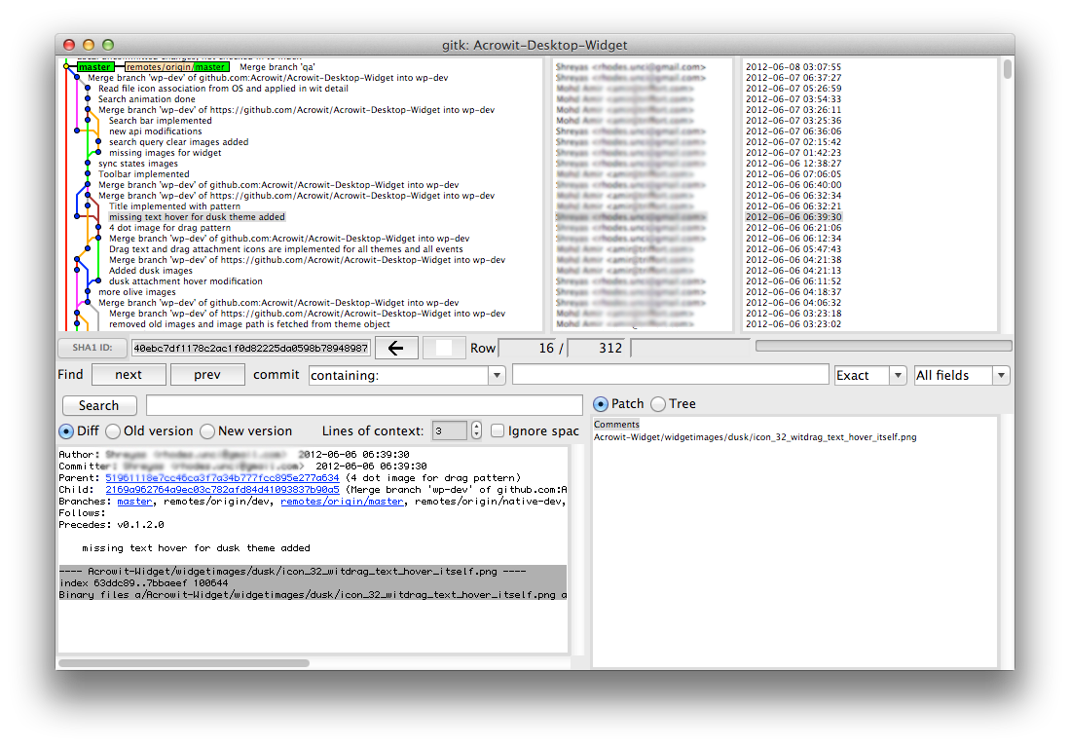
Git Commands
$ gitk
Creating New Repo
Committing
Branching/Merging
Inspection
Cloning a Repo
Updating

Slide 21

Working with others...
github
Creating New Repo
Committing
Branching/Merging
Inspection
Cloning a Repo
Updating

Slide 22

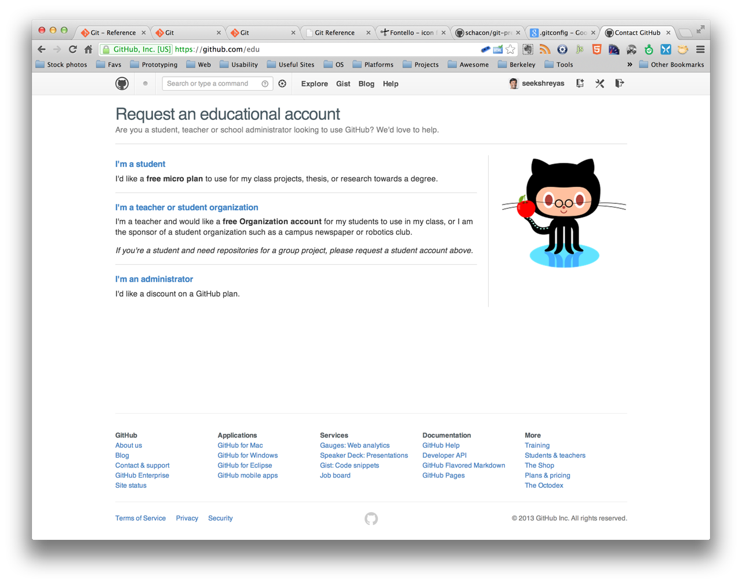
GitHub
create an account
Creating New Repo
Committing
Branching/Merging
Inspection
Cloning a Repo
Updating

Slide 23
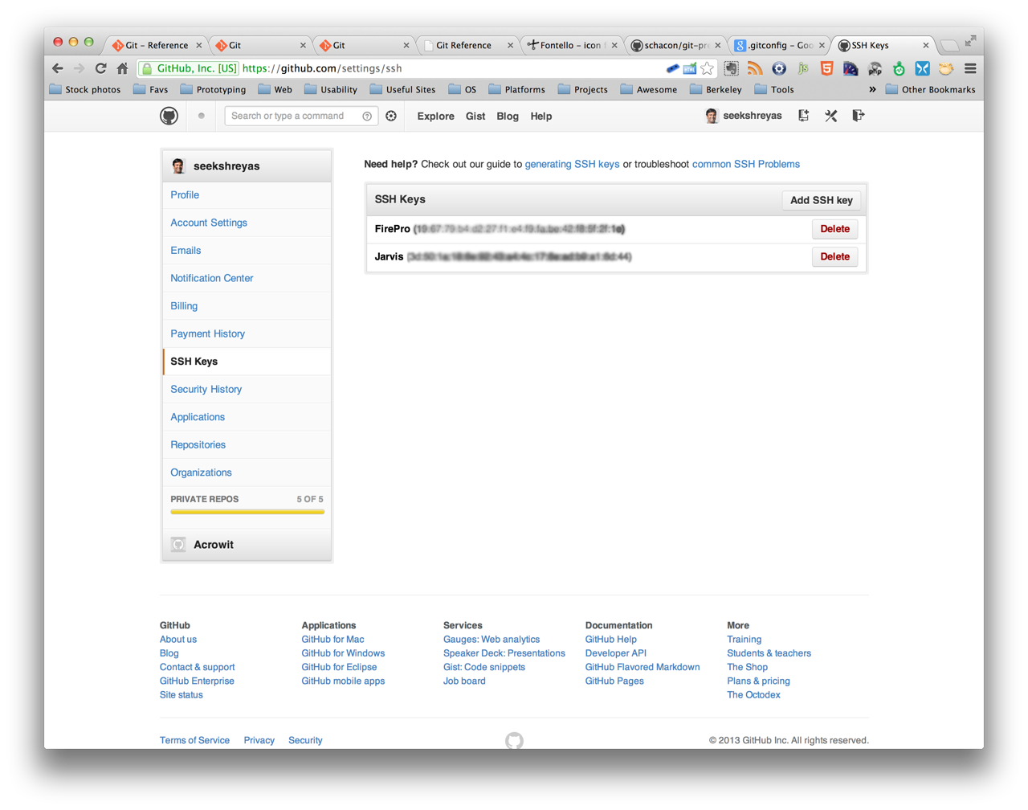
GitHub
add ssh key
Creating New Repo
Committing
Branching/Merging
Inspection
Cloning a Repo
Updating

Slide 24
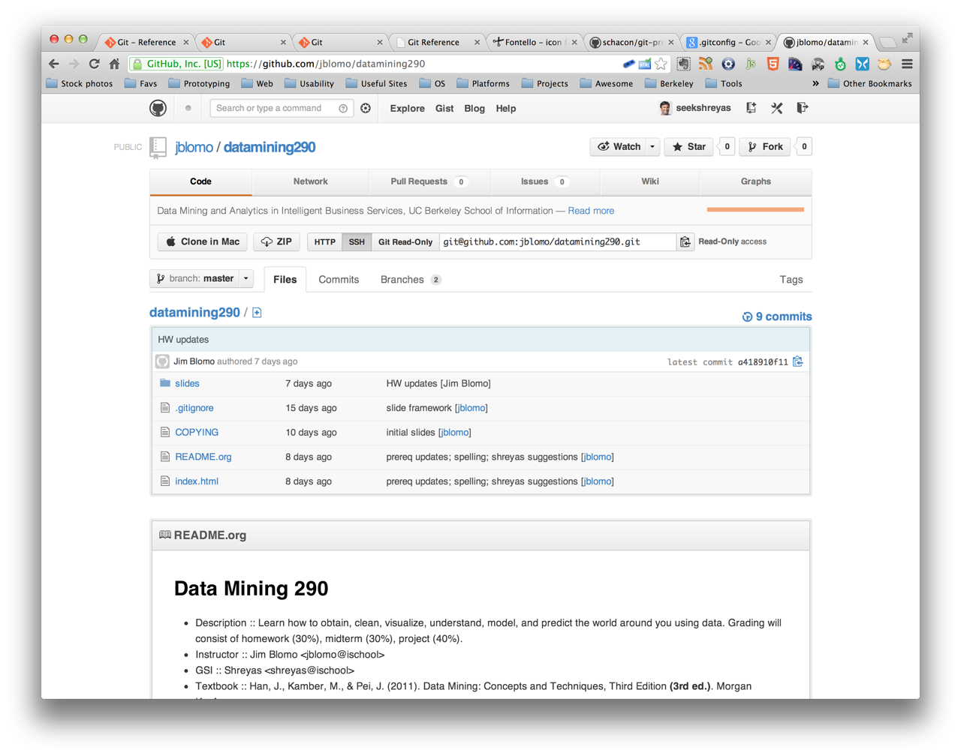
GitHub
$ git clone <url> <name>
Creating New Repo
Committing
Branching/Merging
Inspection
Cloning a Repo
Updating
Notes:
now do a demo of jim workflow

Slide 25
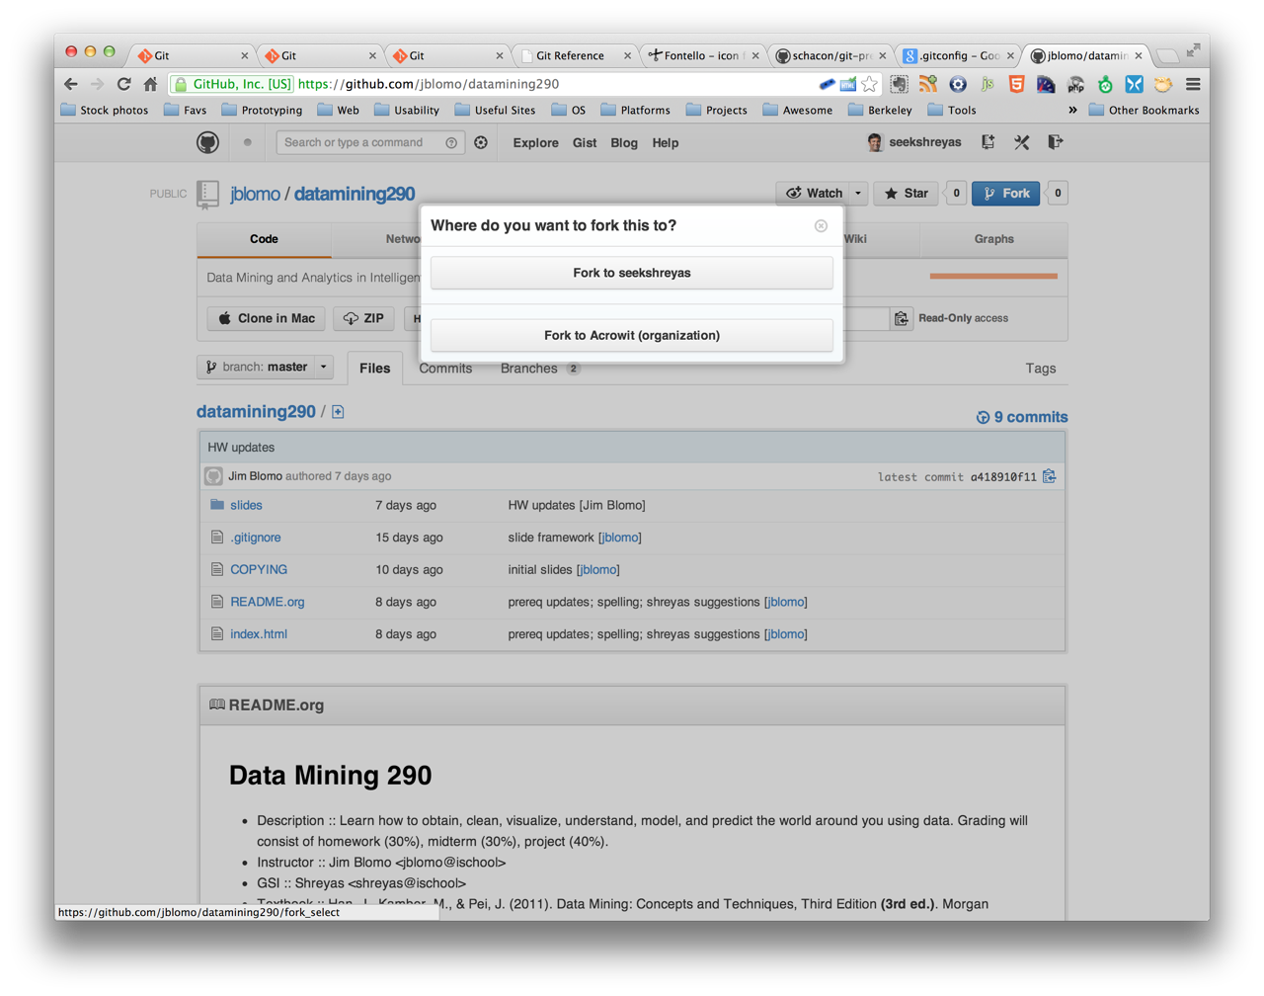
GitHub
Fork a repo
Creating New Repo
Committing
Branching/Merging
Inspection
Cloning a Repo
Updating
Notes:
now show them a demo of creating ssh key on my ischool account

Slide 26
GitHub
$ git pull
Creating New Repo
Committing
Branching/Merging
Inspection
Cloning a Repo
Updating
= git fetch + git merge
$ git push

Slide 27
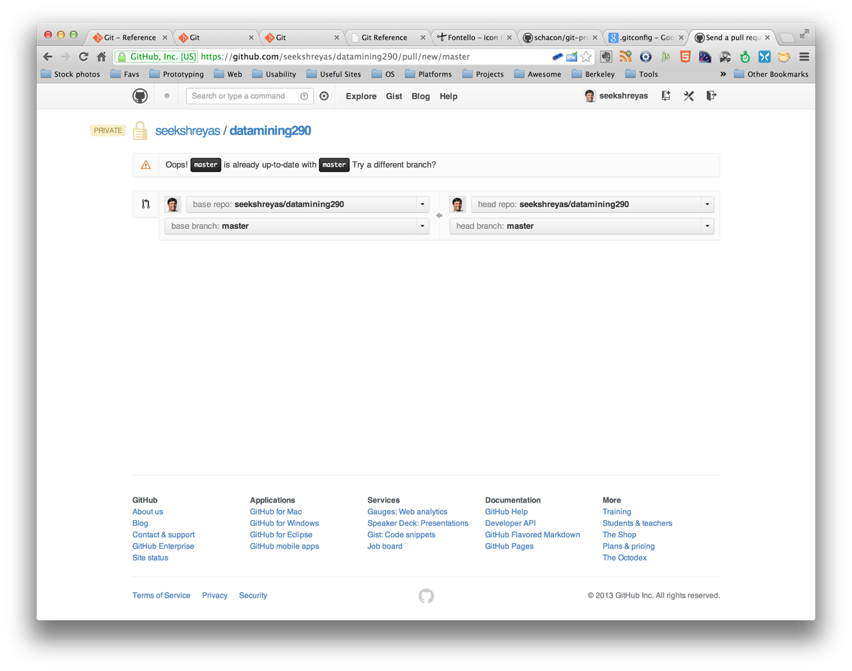
GitHub
GitHub Pull Request
Creating New Repo
Committing
Branching/Merging
Inspection
Cloning a Repo
Updating
Notes:
show the students

Slide 28

GitHub Ninja Features
Markdown
for documentation
Pages
for project hosting
Gist
for project hosting
Notes:
show the students

Slide 29


DEXTOR
IIIrd CSE A
Thank you

